Slide 1


HOTEL RESERVATION ANALYSIS WITH SQL
K.M. NAIMUDDIN
June 26, 2024

Slide 2

Introduction
Purpose
The hotel industry relies on data to make informed decisions and enhance guest experiences. By analyzing reservation data, hotels can identify trends, preferences, and areas for operational improvements.
Goals
The goals of this analysis are to uncover insights into guest preferences, booking trends, and key factors affecting hotel operations. This will help in optimizing marketing strategies and improving overall guest satisfaction.

Slide 3

Dataset Overview
Booking_ID: Unique identifier for each reservation.
no_of_adults: Number of adults in the reservation.
no_of_children: Number of children in the reservation.
no_of_weekend_nights: Nights falling on weekends.
no_of_week_nights: Nights falling on weekdays.
type_of_meal_plan: Meal plan chosen by guests.
room_type_reserved: Type of room reserved.
lead_time: Days between booking and arrival.
arrival_date: Date of arrival.
market_segment_type: Market segment of the reservation.
avg_price_per_room: Average price per room.
booking_status: Status of the booking.

Slide 4






Total Number of Reservations
INSIGHTS:
700
Total reservations count.
Any notable trends or observations.

Slide 5
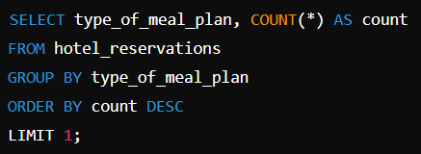
Most Popular Meal Plan
INSIGHTS:
MEAL PLAN 1 - 527
The most popular meal plan among guests.
Possible reasons for its popularity.

Slide 6
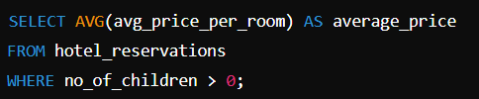
Average Price per Room for Reservations with Children
INSIGHTS:
144.56
Average room price for reservations involving children.
Comparison with overall average room price.

Slide 7
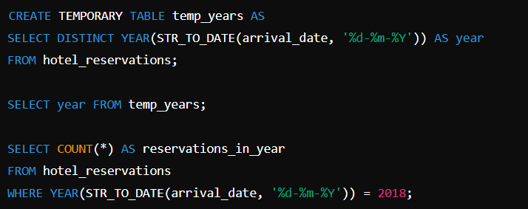
Reservations by Year
INSIGHTS:
2018- 577
Number of reservations for a specific year.
Yearly trends and patterns.

Slide 8
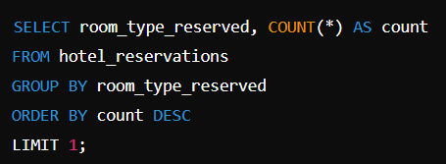
Most Commonly Booked Room Type
INSIGHTS:
ROOM TYPE 1 -534
The most frequently booked room type.
Possible reasons for its popularity.

Slide 9
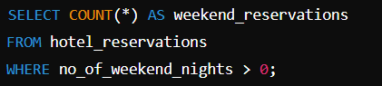
Weekend Reservations
INSIGHTS:
383
Number of reservations including weekend nights.
Comparison with weekday reservations.

Slide 10
Lead Time for Reservations
INSIGHTS:
443 --- 0
Highest and lowest lead time for bookings.
Implications for hotel operations and marketing.

Slide 11
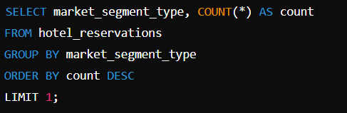
Common Market Segment
INSIGHTS:
ONLINE - 518
Most common market segment.
Insights into guest demographics and behavior.

Slide 12
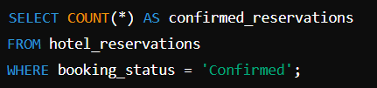
Confirmed Reservations
INSIGHTS:
0
Number of confirmed bookings.
Importance of confirmation rates.

Slide 13
Total Adults and Children
INSIGHTS:
TOTAL ADULTS -1316
TOTAL CHILDREN - 69
Total number of adults and children.
Family travel trends.

Slide 14
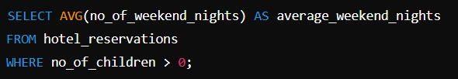
Average Weekend Nights for Reservations with Children
INSIGHTS:
1.00
Average number of weekend nights for families.
Family preferences for weekend stays.

Slide 15
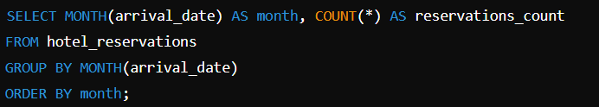
Monthly Reservations
INSIGHTS:
700
Number of reservations each month.
Seasonal trends and peak booking times.

Slide 16
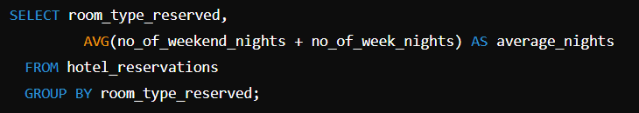
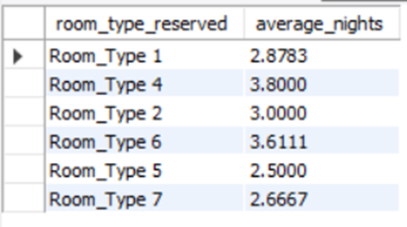
Average Nights per Room Type
INSIGHTS:
Average duration of stay per room type.
Preferences for different room types.

Slide 17
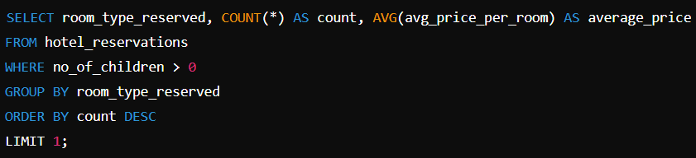
Most Common Room Type and Average Price for Families
INSIGHTS:
ROOM TYPE 1
count - 24
AVERAGE PRICE - 123.12
Most common room type for families.
Average price for that room type.

Slide 18
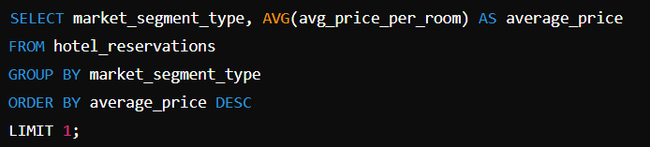
Highest Average Price per Market Segment
INSIGHTS:
ONLINE - 112.45
Market segment with the highest average room price.
Strategic insights for targeting high-value segments.

Slide 19





Conclusion
Total Reservations
Popular Meal Plan
700 total reservations.
Meal Plan 1, chosen in 527 reservations.
Yearly Trends
Common Room Type
577 reservations in 2018, indicating a peak.
Room Type 1, with 534 bookings.
Market Segment
Online segment, with 518 reservations.

Slide 20




Implications for hotel operations and marketing.
Operational Planning:
Optimize inventory and staffing based on trends and lead times.
Marketing Strategies:
Target campaigns and promotions based on popular meal plans and booking channels.
Revenue Management:
Implement dynamic pricing strategies to maximize revenue.
Customer Experience:
Tailor services to meet guest preferences and enhance satisfaction.

Slide 21

Key Points Recap
In conclusion, the data-driven approach to hotel reservation analysis not only uncovers valuable insights but also provides actionable recommendations to enhance operational efficiency and drive marketing effectiveness, ultimately contributing to better guest experiences and increased profitability.

Slide 22





K.M. NAIMUDDIN
Batch Name: MIP-DA-10
(+880) 1869555571
Kmnaimuddin.cse@gmail.com
k-m-naimudin
KMNaim

